Slide 1

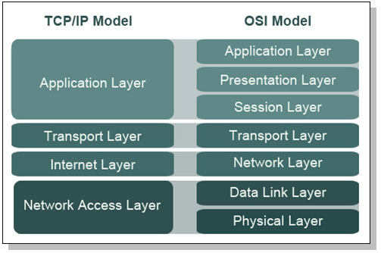


Slide 2
Uses of computer networks
Computer networks are collections of autonomous computers, e.g., the Internet
They have many uses:
Business Applications »
Home Applications »
Mobile Users »
These uses raise:
Social Issues »
This text covers networks for all of these uses

Slide 3
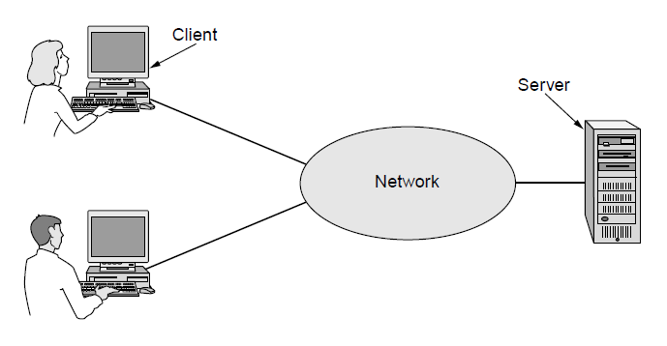
Companies use networks and computers for resource sharing with the client-server model:
Other popular uses are communication, e.g., email, VoIP, and e-commerce
request
response

Slide 4
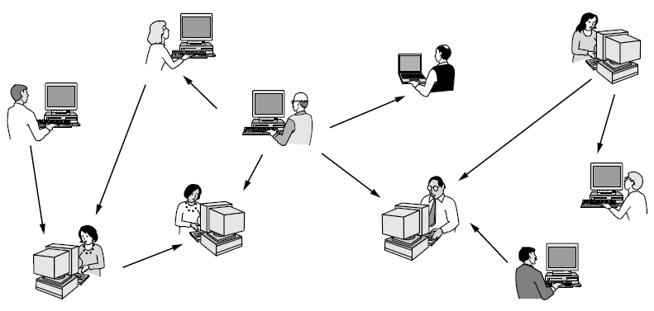
Homes contain many networked devices, e.g., computers, TVs, connected to the Internet by cable, DSL, wireless, etc.
Some application use the peer-to-peer model in which there are no fixed clients and servers:
Hi
Dating with me?
Hi

Slide 5
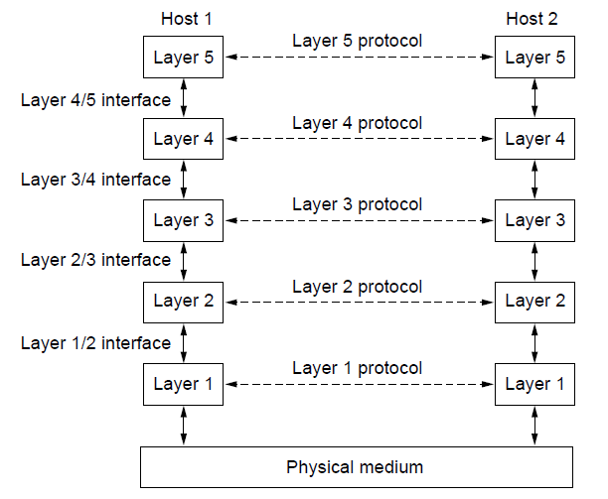

Protocol layering is the main structuring method used to divide up network functionality.
Each protocol instance talks virtually to its peer
Each layer communicates only by using the one below
Lower layer services are accessed by an interface
At bottom, messages are carried by the medium

Slide 6
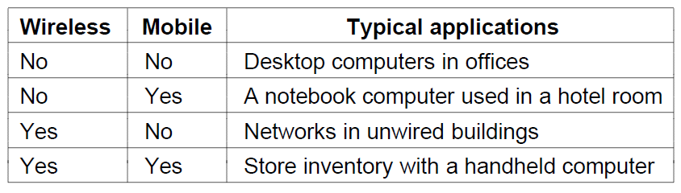
Tablets, laptops, and smart phones are popular devices; WiFi hotspots and 3G/4G/5G cellular provide wireless connectivity.
Mobile users communicate, e.g., voice and texts, consume content, e.g., video and Web, and use sensors, e.g., GPS.
Wireless and mobile are related but different:

Slide 7
Networks can be classified by their scale:
Scale | Type
Vicinity | PAN (Personal Area Network) »
Building | LAN (Local Area Network) »
City | MAN (Metropolitan Area Network) »
Country | WAN (Wide Area Network) »
Planet | The Internet (network of all networks)

Slide 8
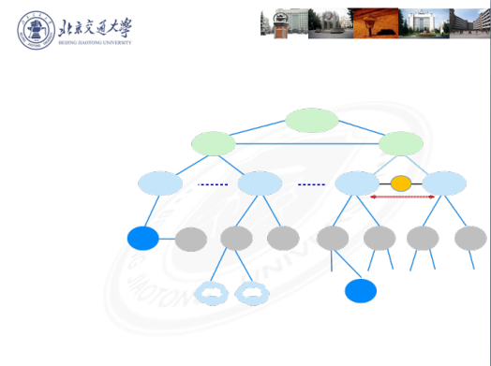


Wide Area Network
Tier-1 ISP
CN-China Telecom
CN-China Unicom
US-AT&T
US-Verizon
US-Sprint
JP-NTT
JP-KDDI
SingTel
UK-British Telecom
Tier One
ISP
Backbone
ISP
Backbone
ISP
Region ISP
Region ISP
Region ISP
IX Region P ISP
Enterprise
Local
ISP
Local
ISP
Local
ISP
Local
ISP
Local
ISP
Local
ISP
Local
ISP
DE-Deutsche Telekom
Tier-2 ISP
CERNET ̵China Mobile
Pay to the higher level ISP
campus
network
BJTU
network
Compan
y

Slide 9

Internet
The modern Internet is more complex:
• ISP networks serve as the Internet backbone
• ISPs connect or peer to exchange traffic at IXPs
• Within each network routers switch packets
• Between networks, traffic exchange is set by business agreements
• Customers connect at the edge by many means
• Cable, DSL, Fiber-to-the-Home, 4G/5G wireless, dialup
• Data centers concentrate many servers (“the cloud”)
• Most traffic is content from data centers (esp. video)
• The architecture continues to evolve

